Slide 1
Data4u Initiative
“The learning tools you never knew you had”
-
Start your data-driven tomorrow today!

Slide 2
What is Data4u?
Data4u is an initiative aiming to facilitate access to data analysis and learning experience resources for students of higher education institutions.
The idea emerged in the context of the COVID pandemic, when an unprecedented shift accelerated the digital transition and further consolidated the role of data as the commodity of the future.
To bridge the gap between traditionally available resources and the evolving needs of the job market, we carefully selected a portfolio of leading tools and related training made available for free.

Slide 3

What is Tableau?
The first round of the Data4u Initiative is centered around Tableau.
According to Tableau:
  “…Tableau is the most powerful, secure, and flexible end-to-end analytics platform for your data... Designed for the individual, but scaled for the enterprise, Tableau is the only business intelligence platform that turns your data into insights that drive action.”
Tableau has been adopted by:
  OCP SA, Nike, Coca-Cola, Skype, The World Bank, The New York Times…

Slide 4
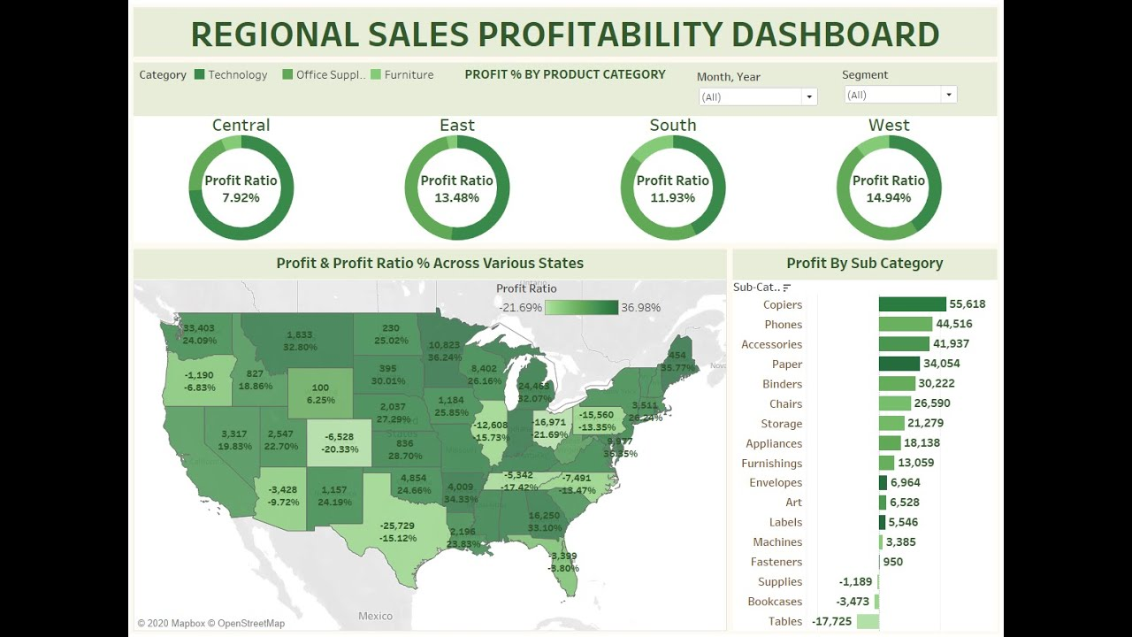
Example of Tableau Dashboard
Source: Abhishek Agarrwa

Slide 5
What is Tableau for Students?
Tableau for Students is a free one-year Tableau license offered to students at accredited academic institutions, including:
  Tableau Desktop;
  Tableau Prep;
  Access to the entire eLearning suite;
  Discounts for the Tableau Desktop Specialist Exam;
  Activation on up to 2 devices.
The license can be renewed for free as long as the student is still enrolled.
This license can be used:
  In class;
  At home;
  During internships.
Value of license: $999/year/student

Slide 6
What is Tableau for Teaching?
Tableau for Teaching is a free renewable one-year Tableau license offered for teaching at accredited academic institutions, including:
  Instructor License;
  Student Bulk License: classroom license requested by the instructor for their students to learn Tableau (including part-time students);
  Tableau Online Site: cloud-based workspace for instructors and students to collaborate.

Slide 7
Thank you!

